Slide 1
Incentives and COVID-19 Vaccinations Replication Project
Molly Marino

Slide 2

Overview of the Original Study
• Study design: Factorial survey experiment with 20,500 participants across Germany
• Timing: March 5–25, 2021 (during the pandemic peak)
• Three policy dimensions tested:
– Financial incentives (€25 and €50 cash rewards)
– Enhanced freedoms for vaccinated individuals
– Vaccination access through local doctors (local GP)
• Goal: Address vaccine hesitancy and increase vaccination coverage
(2)
Notes:
This study aimed to understand how governments could encourage more people to get vaccinated during COVID-19.
Researchers used a factorial survey experiment, meaning participants were shown different combinations of incentives and asked how willing they would be to get vaccinated.
The sample was large and based in Germany, making the findings fairly reliable for similar populations.
Three main types of incentives were tested: freedoms (like access to travel), financial payments, and easier access through local doctors.
Participants were divided into three groups based on their attitudes: those willing to vaccinate, those undecided, and those refusing.
The main takeaway is that incentives do work, but mostly for people who are unsure rather than those strongly against vaccination.

Slide 3

Research Methodology and Data
Study Design & Data
Analytical Approach
• Factorial survey experiment • Participants rated vaccination willingness on a 0–1 scale for each policy scenario
• Linear regression models with individual fixed effects • Controlled for unobserved participant characteristics • Causal forests (machine learning) used to examine treatment effect heterogeneity • Heterogeneity analysis across age, trust, and risk preferences • Three R scripts: data preparation, main results, heterogeneous effects
(3)
Notes:
Participants were presented with hypothetical vaccination scenarios in which different combinations of incentives were varied. They were then asked how likely they would be to get vaccinated under each scenario. Importantly, the study measures intention to vaccinate rather than actual behaviour. Participants were also categorised based on their initial attitudes as willing, undecided, or refusing vaccination, which allowed the researchers to examine how different groups responded to the same incentives.
To analyse the data, the researchers used linear regression models with individual fixed effects, which help control for unobserved individual characteristics such as personal beliefs or attitudes that could influence responses. They estimated the average treatment effect of each incentive, meaning the overall impact on vaccination willingness. In addition, the study used causal forest models, a machine learning method, to explore heterogeneous treatment effects, or how the impact of incentives varies across individuals. For example, they examined differences based on age, levels of trust, and risk preferences, highlighting that incentives do not work equally for everyone. Finally, the analysis was conducted using a structured and reproducible workflow, with separate scripts for data preparation, main results, and heterogeneity analysis.

Slide 4

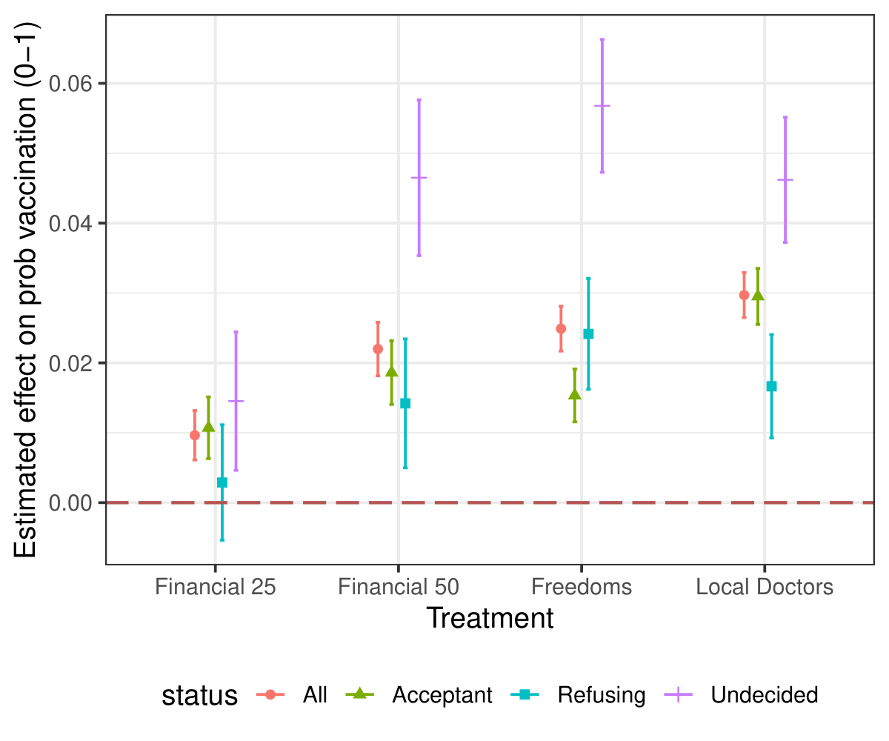
Effect of Incentives on Vaccination Willingness
4
Notes:
The graph shows how different incentives affect the likelihood that people would get vaccinated, with probabilities displayed on a 0–1 scale. Each dot represents the estimated effect of an incentive, and the vertical lines around the dots are 95% confidence intervals, showing the range where the true effect is likely to fall. We can read these probability changes as percentage point increases, so a change from 0.60 to 0.65, for example, means a 5 percentage point increase in willingness. This graph allows us to see both the estimated impact of each incentive and how certain we can be about that estimate.

Slide 5
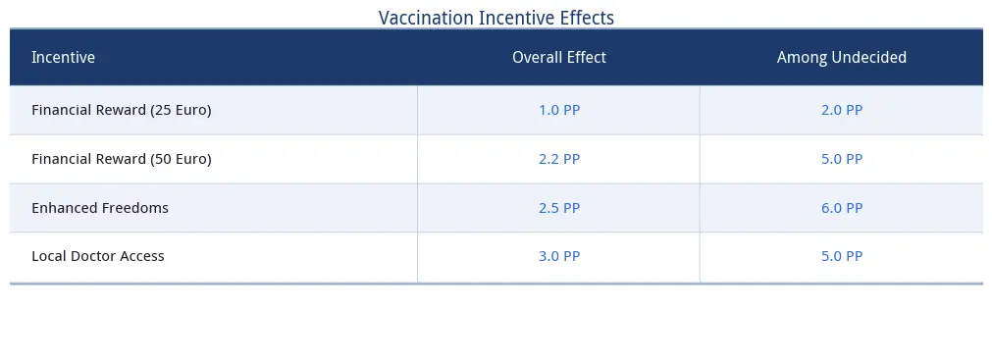
Impact of Policy Incentives
All three incentive types showed positive effects on vaccination willingness.
4
Notes:
All of the incentives tested increased vaccination willingness, but the effects were modest overall. In the full sample, each incentive—financial rewards, enhanced freedoms, or vaccination via a local doctor—raised willingness by around 2–3 percentage points. Among people who were undecided about vaccination, the effects were larger, approximately 5–6 percentage points. This shows that incentives are most effective at influencing hesitant individuals, while their impact on people who are already willing or firmly refusing is smaller. Overall, these results suggest that targeted incentives can meaningfully improve vaccination uptake, especially among those on the fence..

Slide 6

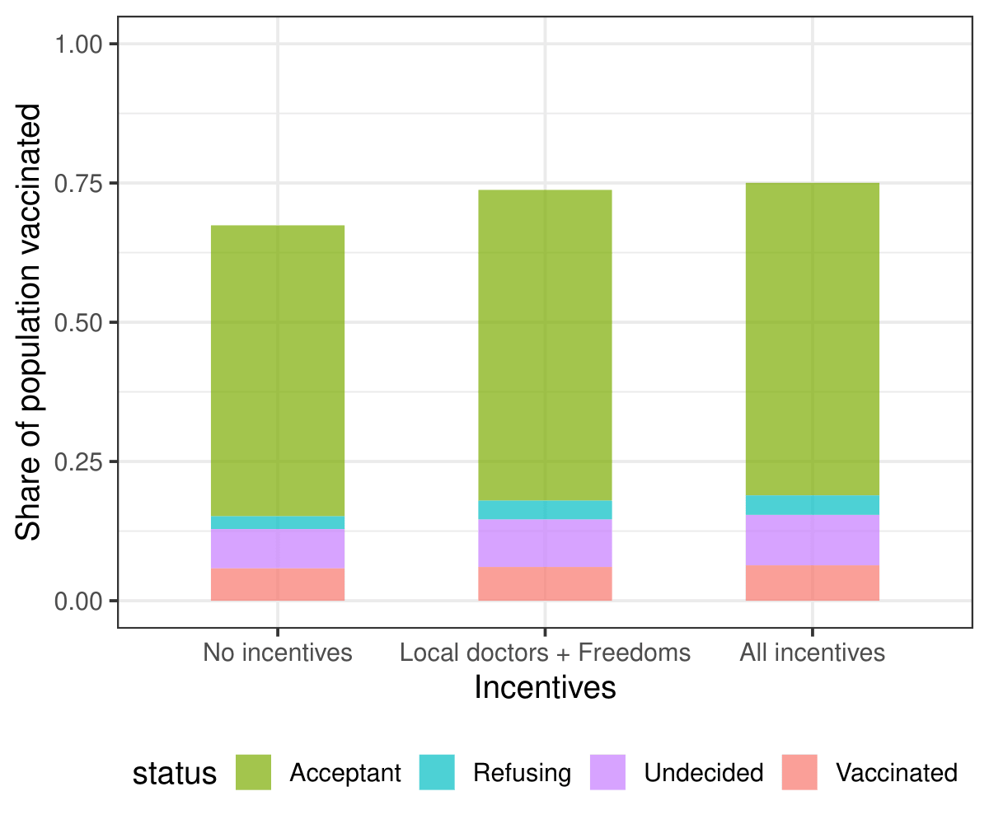
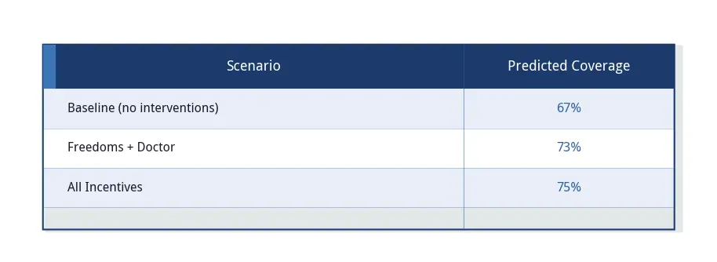
Predicted Vaccination Coverage
Coverage by Incentive Scenario
Notes:
The predicted vaccination coverage graph (panel B) shows how different incentives could increase population-level uptake. At baseline, without any incentives, about 67% of the population is expected to get vaccinated. Introducing enhanced freedoms or making vaccination available through a local doctor raises coverage to approximately 73%. When all incentives are combined — financial rewards, enhanced freedoms, and improved access — predicted coverage increases further to around 80%. This illustrates that while each incentive individually has a modest effect, combining them can substantially increase overall vaccination uptake.

Slide 7
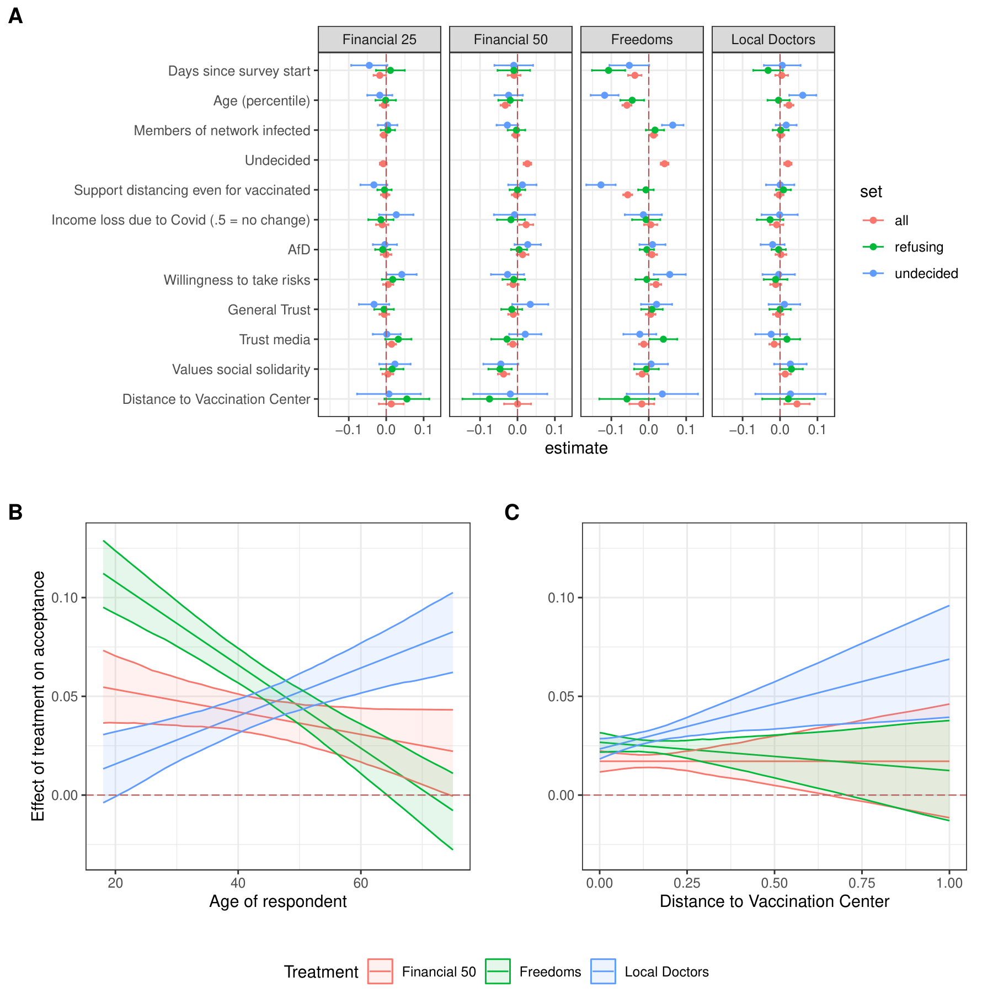
Heterogeneous Effects of Incentives
Heterogeneous Effects for Unwilling Respondents
Forest plot: Dots = effect estimates, lines = 95% CI (uncertainty)
Unwilling/undecided people: Response to incentives varies by subgroup
Key drivers:
Age: Younger → enhanced freedoms; Older → local doctor vaccination
Distance: Farther from vaccination centers → stronger effect of local doctor access
Notes:
Figure 2 examines heterogeneous treatment effects, which means it looks at how the impact of incentives differs across different subgroups of people. The analysis uses a forest plot, a type of graph where each dot represents the estimated effect of an incentive for a particular group or feature, and the horizontal lines indicate the 95% confidence intervals, showing the uncertainty around the estimate. Panel A of the figure identifies which factors are most important in explaining differences in responses, with positive coefficients meaning that higher values of a feature increase the effect of an incentive. Panel B shows that age matters: younger undecided respondents respond most to enhanced freedoms, while older undecided respondents respond more to vaccination through a local doctor. Panel C shows that distance to the nearest vaccination center also matters: the effect of being able to get vaccinated locally increases as people live farther away from vaccination centers, suggesting that reducing travel and other transaction costs can boost uptake. Overall, these heterogeneous effects show that incentives are not equally effective for everyone, and targeted strategies can increase vaccination more efficiently.

Slide 8
Modifications to Original Study
Baseline willingness as a continuous measure:
Captures the full range of prior attitudes, not just broad categories (willing, undecided, refusing).
Allows us to see how responsiveness to incentives varies across individuals.
Trust in government as a key moderator:
Numerous studies have shown that institutional trust strongly predicts vaccine uptake (e.g., Betsch et al., 2015; Lazarus et al., 2021).
People with low trust in government are less likely to follow vaccination recommendations, even when offered incentives.
For hesitant individuals, higher trust increases the likelihood they will accept vaccination, making it more effective than financial incentives alone
Public health importance:
Vaccine hesitancy is a growing global challenge. Understanding who is most responsive to policies helps target interventions efficiently.
Trust in institutions is critical for long-term compliance with vaccination programs and broader public health measures.
Notes:
The original study categorized participants into broad groups — willing, undecided, or refusing — and analyzed how incentives affected each group. While informative, this approach overlooked the “movable middle”, individuals whose willingness to vaccinate is not firmly fixed and who may respond differently than the extremes. By not treating baseline willingness as a continuous measure, the study could not capture the nuanced variation within this middle group. Additionally, the original study did not examine trust in government as a factor influencing vaccination decisions, missing a key driver of public health behavior identified in other research. Ignoring both baseline variation and trust means the study could overlook the subgroups that are most responsive to interventions, limiting the insights available for designing effective, targeted vaccination policies.

Slide 9
Modification: The Role of Trust in Government
Estimated two interaction regression models predicting vaccine hesitancy
Model 1: Baseline attitudes X trust in government
Model 2: Baseline attitudes X financial incentives
All variables standardized
Mean=0 and Standard deviation=1
Coefficients interpreted as SD changes in vaccine hesitancy
Assessed which predictor better describes variations in vaccine hesitancy
Used financial incentives to compare as a benchmark from the original study
Notes:
I estimated two separate interaction regression models to examine predictors of vaccine hesitancy. In the first model, I included baseline attitudes, trust in government, and their interaction term, which allowed me to test both the direct effect of trust and whether trust modifies the relationship between baseline attitudes and vaccine hesitancy. The second model replicated the same structure but replaced trust with financial incentives, which served as a comparison variable based on the original study. This approach ensured consistency in model specification and allowed for a direct comparison between predictors. All key variables were standardized into z-scores, giving them a mean of 0 and a standard deviation of 1, which makes the coefficients interpretable as changes in vaccine hesitancy in standard deviation units and allows effect sizes to be directly compared across variables. I then compared the two models by examining the magnitude of the standardized coefficients, their statistical significance, and the strength of the interaction terms. The goal of this approach was to assess whether a psychological factor (trust in government) or a material factor (financial incentives) is more important in explaining variation in vaccine hesitancy, while also accounting for how these factors interact with baseline attitudes.

Slide 10

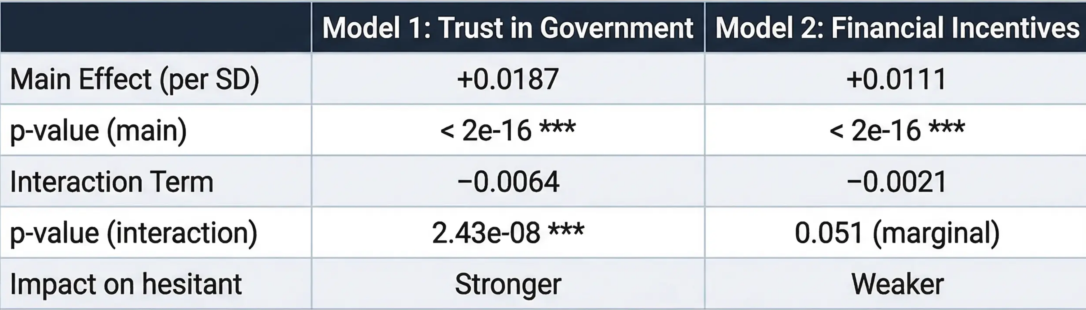
Comparing Trust and Financial Incentives
Trust in government demonstrates a stronger impact than financial incentives.
The trust effect (0.0187) is approximately 69% larger than the financial incentive effect (0.0111), and the interaction is more statistically robust.
Notes:
The analysis shows that trust in government has a significant effect on vaccine hesitancy. Specifically, a 1-unit increase in trust is associated with a 0.0187-unit increase in vaccine attitudes (β = 0.0187, p < .001), whereas a 1-unit increase in financial incentives is associated with a much smaller change (β = 0.00111). Trust also moderates the effect of baseline hesitancy, with a 1-unit increase in trust reducing the influence of prior hesitancy by 0.0064 units (β = −0.0064, p < .001), while the comparable interaction for financial incentives is weaker (β = −0.0021). These results indicate that trust in government exerts both a stronger direct effect and a more substantial moderating effect on vaccine hesitancy compared with financial incentives.

Slide 11
Policy Implications and Conclusions
Prioritize Trust Building
2. Transparent Communication
3. Strategic use of financial incentives
Notes:
I estimated two separate interaction regression models to examine predictors of vaccine hesitancy. In the first model, I included baseline attitudes, trust in government, and their interaction term, which allowed me to test both the direct effect of trust and whether trust modifies the relationship between baseline attitudes and vaccine hesitancy. The second model replicated the same structure but replaced trust with financial incentives, which served as a comparison variable based on the original study. This approach ensured consistency in model specification and allowed for a direct comparison between predictors. All key variables were standardized into z-scores, giving them a mean of 0 and a standard deviation of 1, which makes the coefficients interpretable as changes in vaccine hesitancy in standard deviation units and allows effect sizes to be directly compared across variables. I then compared the two models by examining the magnitude of the standardized coefficients, their statistical significance, and the strength of the interaction terms. The goal of this approach was to assess whether a psychological factor (trust in government) or a material factor (financial incentives) is more important in explaining variation in vaccine hesitancy, while also accounting for how these factors interact with baseline attitudes.

